Slide 1



Panelists
Tony Frank Director of Business Development PCs for People afrank@pcsforpeople.org | Tracy Treece Digital Inclusion Manager Denver Public Library ttreece@denverlibrary.org | Melanie Colletti Digital Equity Manager Office of the Future of Work Colorado Department of Labor & Employment melanie.colletti@state.co.us

Slide 2
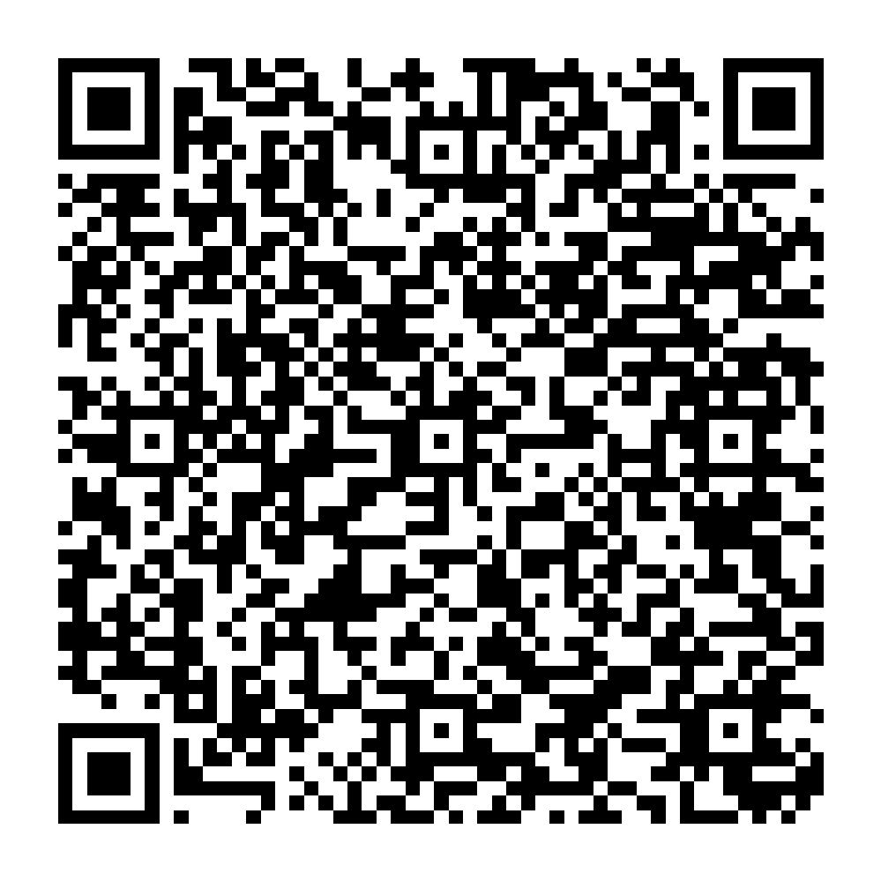
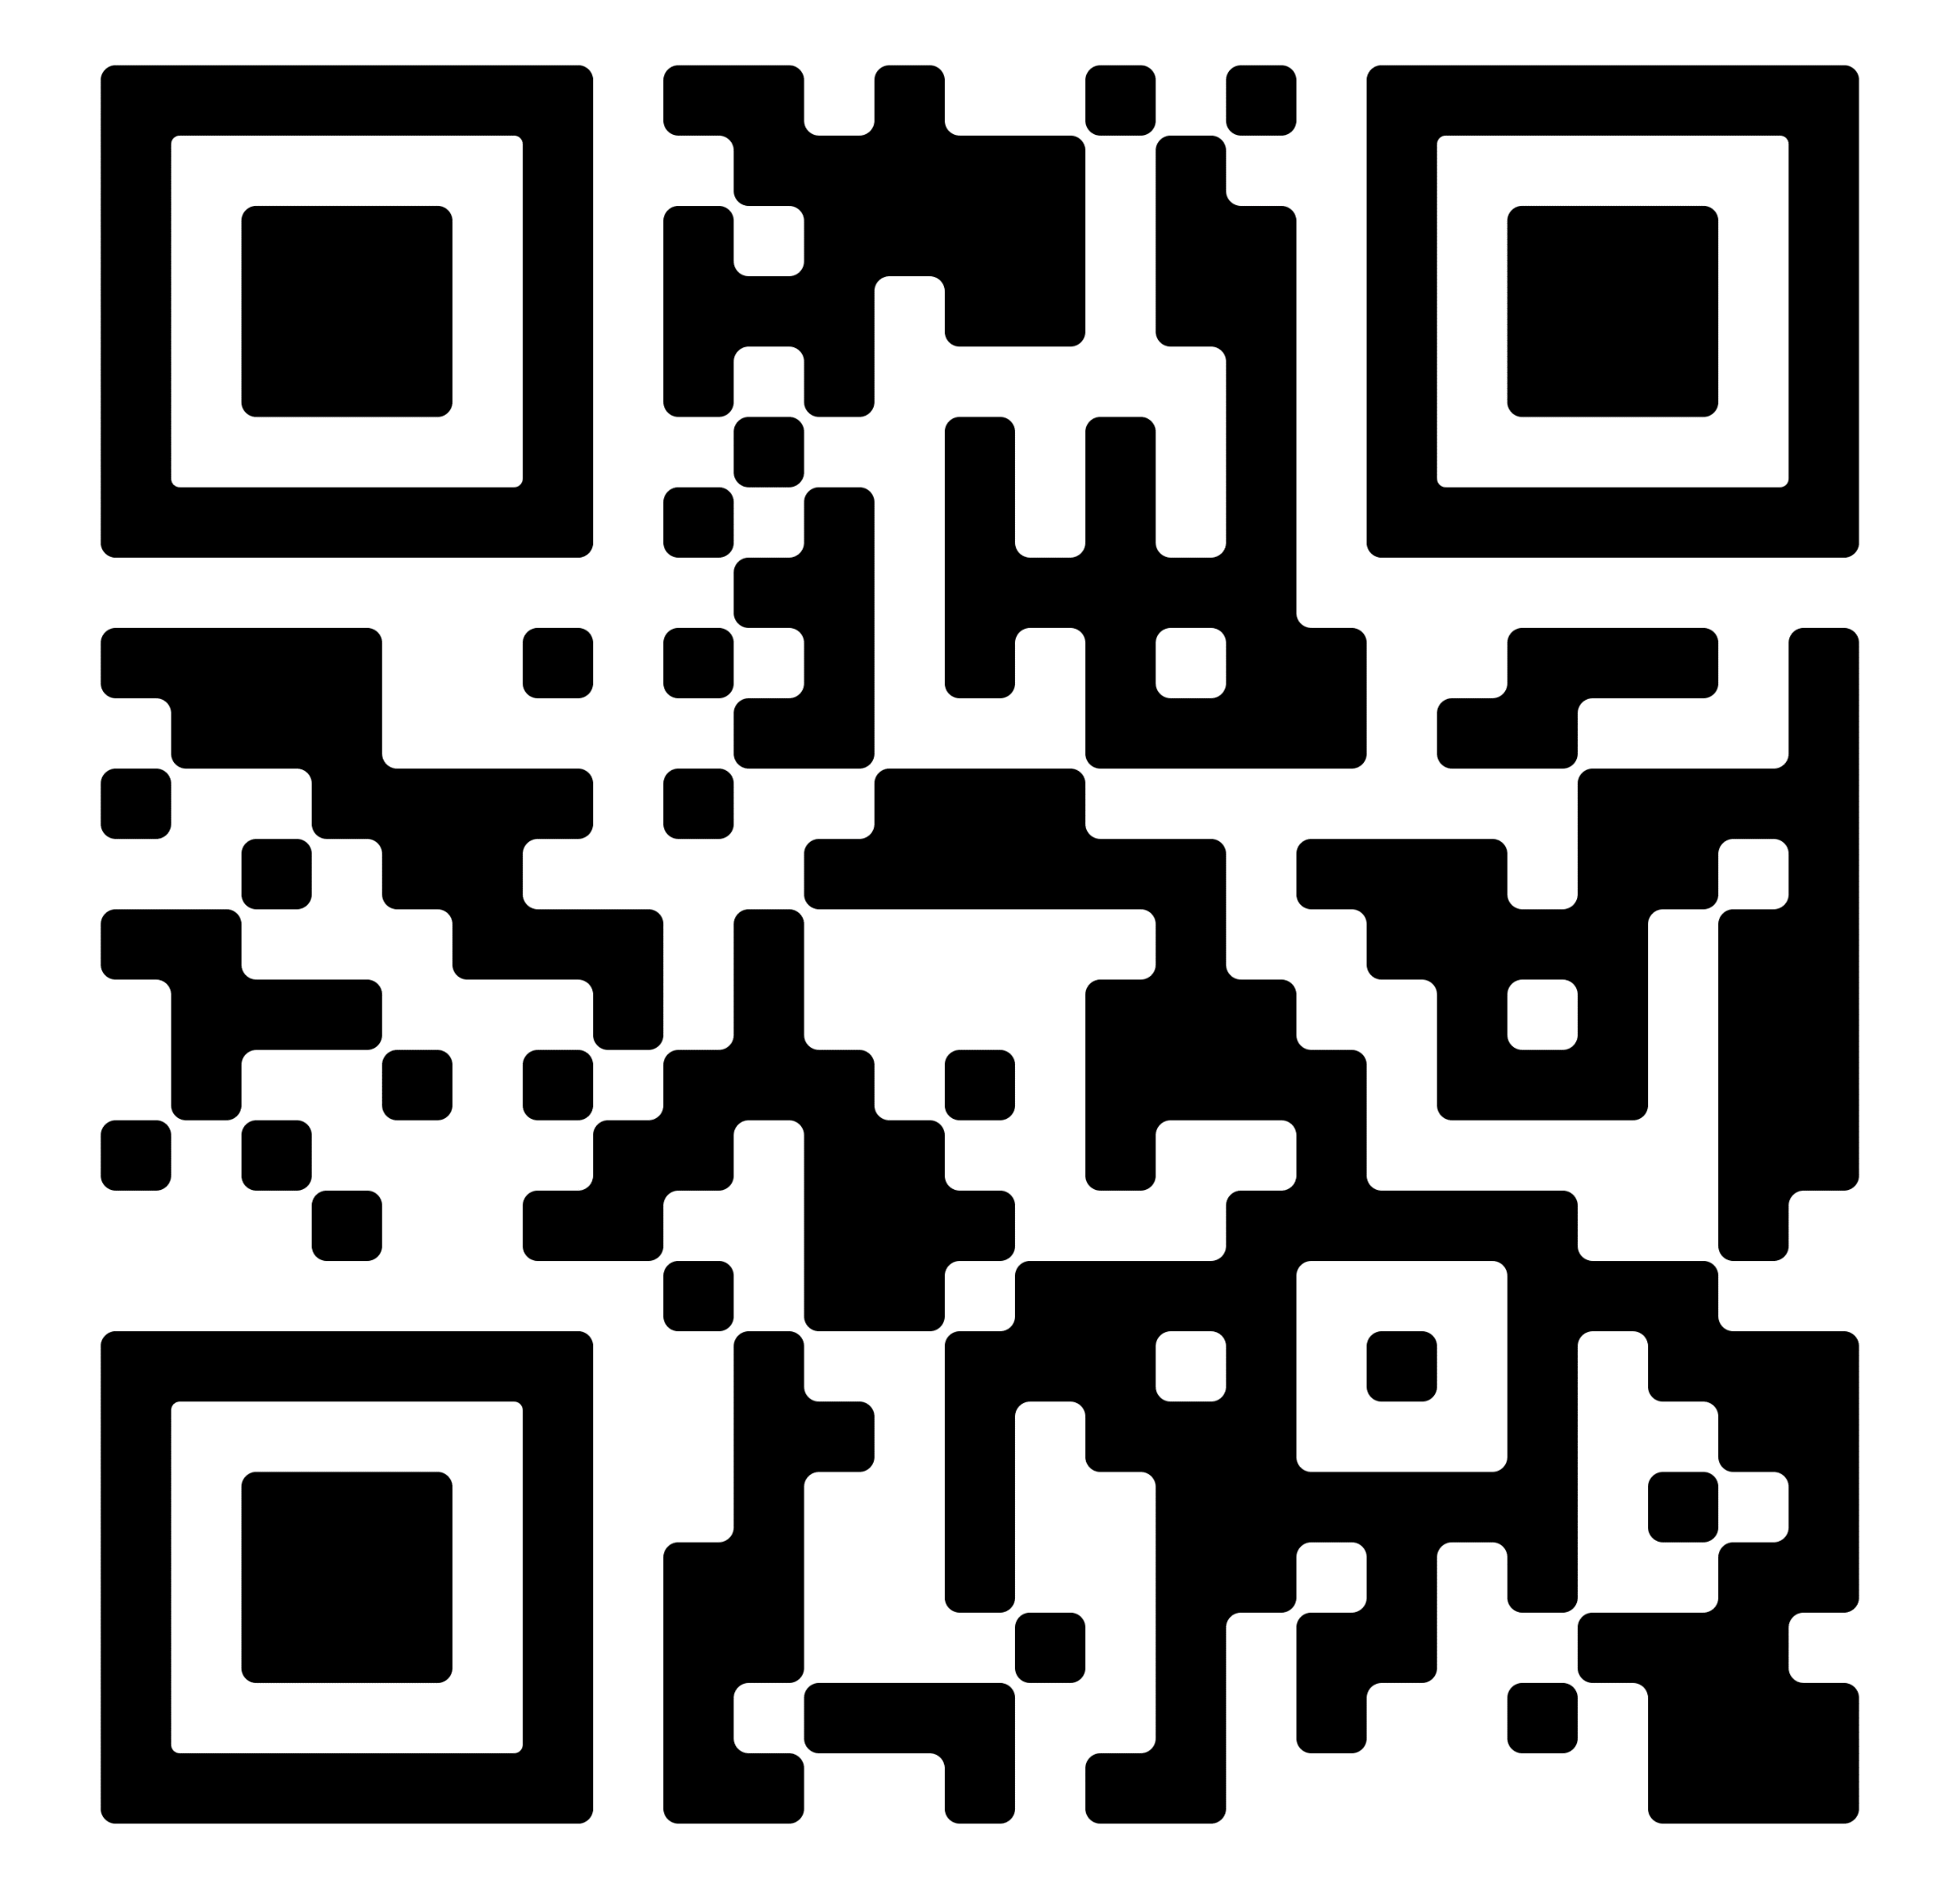
Colorado Digital Equity Survey & DEEM Tool
Public Digital Equity Survey
For individuals, especially those most impacted by lack of device access and lack of skills
Digital Equity Ecosystem Mapping
For non-profits, local governments, healthcare providers, schools, libraries – any organization related to digital inclusion in any way

