Slide 1
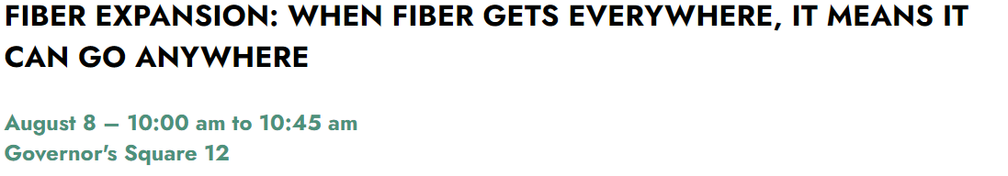


Slide 2
Fiber Deployment
August 2023

Slide 3


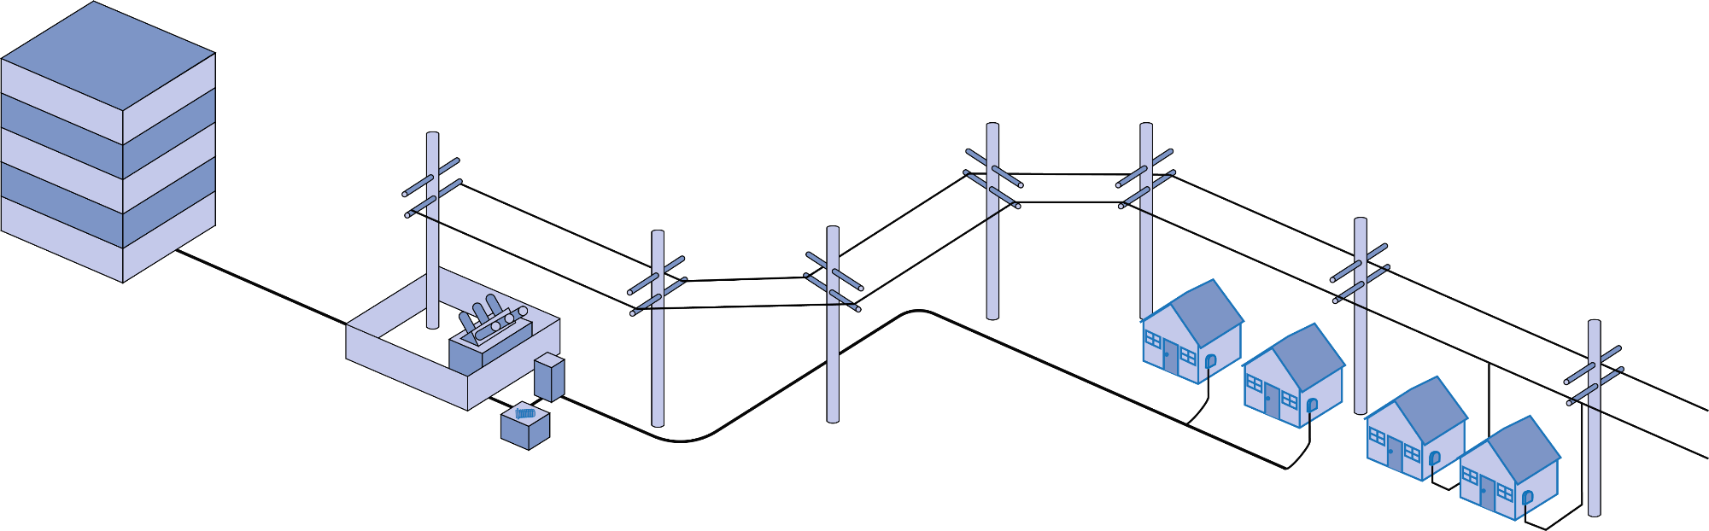









Simplified FTTH Network
HEAD END CENTRAL OFFICE DATA CENTER
SUBSTATION

Slide 4
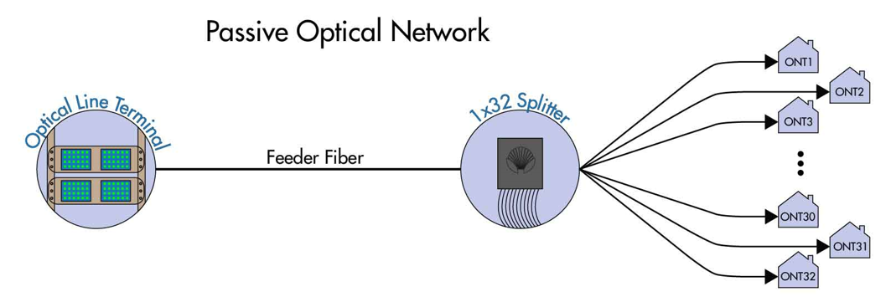
Network Architectures

Slide 5
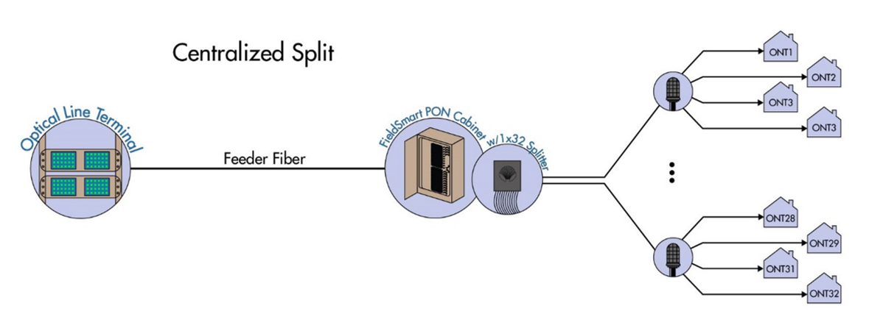
Network Architectures

Slide 6
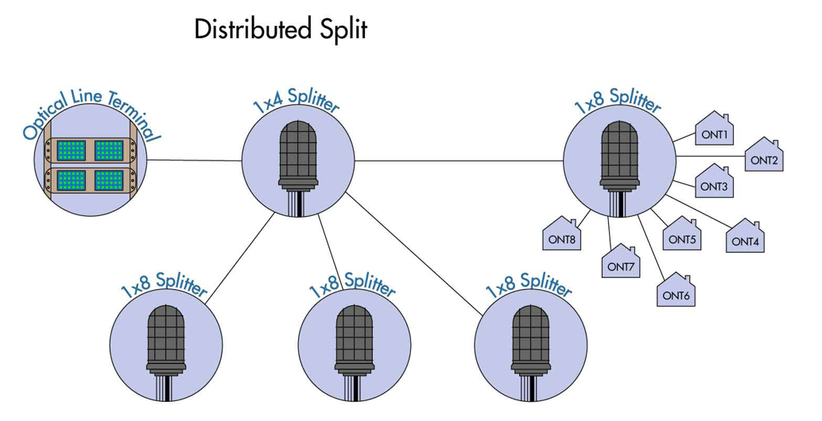
Network Architectures

Slide 7
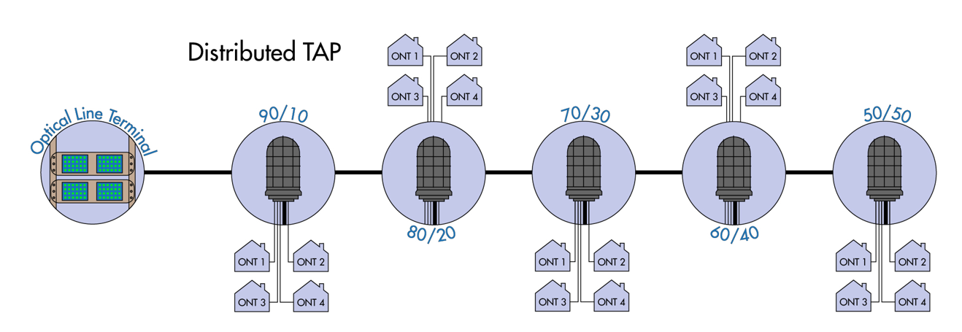
Network Architectures

Slide 8
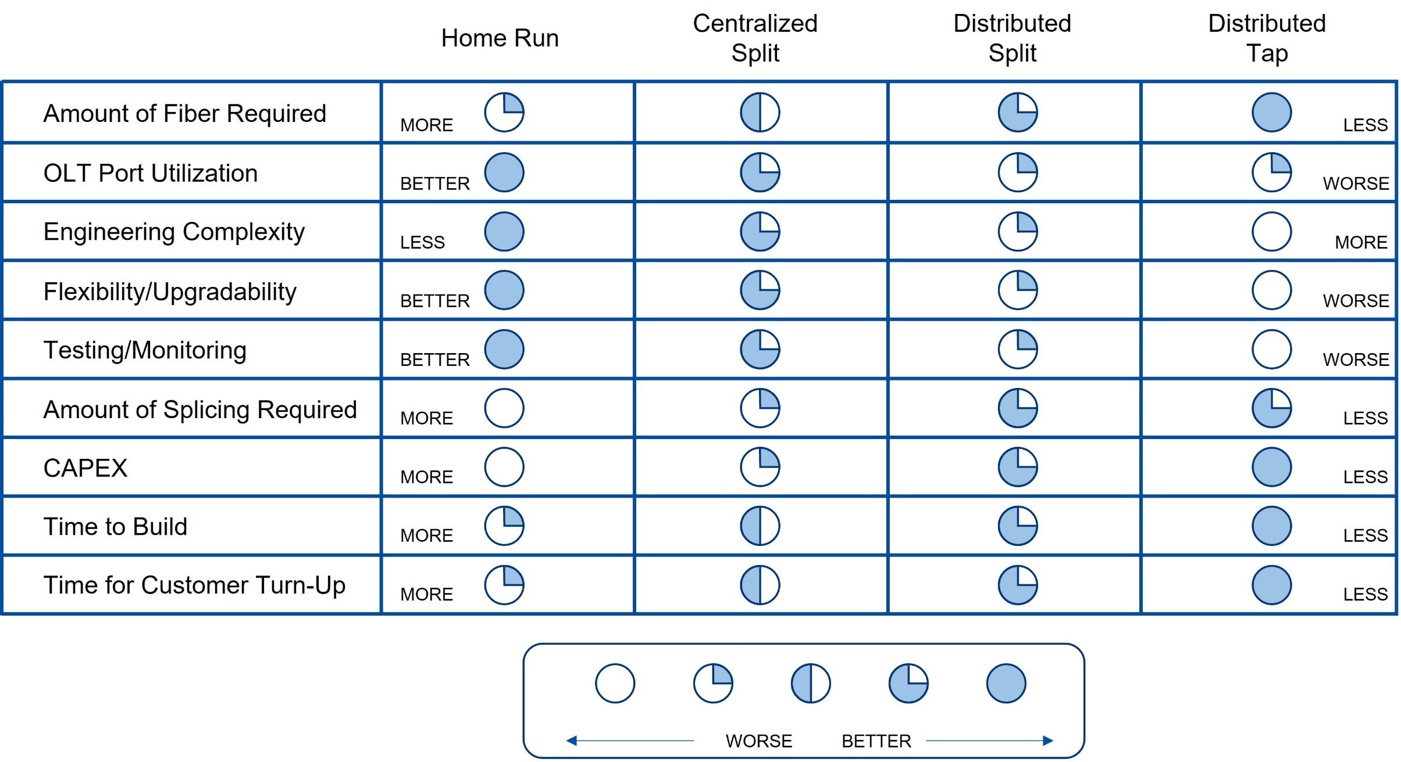
PON Topologies Trade-Offs

